Slide 1
FHIR for Architects
Lloyd McKenzie
Sept. 27-29, 2017

Slide 2

Who am I?
Name: Lloyd McKenzie
Company: Gevity
Background:
One of FHIR’s 3 initial editors
Co-chair FMG, FHIR-I and MnM
HL7 Fellow
Heavily involved in HL7 and healthcare exchange for last 17 years (v2, v3, CDA, etc.)
lmckenzie@gevityinc.com

Slide 3
This presentation
Can be downloaded here:
https://github.com/FHIR/documents/blob/master/presentations/2017-09%20Webinars/FHIR%20for%20Architects.pptx
Use “anonymous” and email address to logon
Is licensed for use under the Creative Commons, specifically:
Creative Commons Attribution 3.0 Unported License
(Do with it as you wish, so long as you give credit)

Slide 4
Tutorial Objectives
You should know
FHIR’s interoperability paradigms (and where to use)
Where FHIR can fit in the architectural stack
FHIR architectural considerations and how to address them
Where and how Profiles fit into an architectural solution
If, when and how FHIR might be used within your own organization
Notes:
Have < 3 hours so focus is more on “identifying considerations” than deeply exploring options

Slide 5
Level Setting
Should be familiar with basics of FHIR – from Introduction to FHIR or equivalent presentation or experience
This presentation won’t drill into the hands on details of messaging, documents, XML or JSON syntax, etc.
Focus will be high level architecture considerations – will get through as much as we can . . .

Slide 6
Agenda
Paradigms & Architecture approaches
FHIR Features & Architecture decision
Additional considerations, Profiles & Next steps

Slide 7
What Paradigm

Slide 8
Paradigms
FHIR supports 4 interoperability paradigms
REST
Documents
Messages
Services
What should you use when?
Notes:
Temperature check – how many people feel they’ve got a good handle on the paradigms and when they’d use them vs. not. (This isn’t really FHIR-specific)

Slide 9
REST
Simple, out-of-the-box interoperability
Leverage HTTP: GET, POST, etc.
Pre-defined operations
Create, Read, Update, Delete
Also: Read Version, Search (resource/type/server), History (resource/type/server), Capabilities, Patch, Batch & Transaction
Rest
Notes:
Review

Slide 10
FHIR Resource URLs
Template | Description | Example | Operations
[base] | Server URL | http://fhir.com | GET, POST
[base]/[type] | Collection Manager | http://fhir.com/Patient | GET, POST
[base]/[type]/[id] | URL for a resource | http://fhir.com/Patient /23 | GET, PUT, DELETE, PATCH
[base]/[type]/[id]/_history/[vid] | Past version | http://fhir.com/Patient/23/_history/2 | GET
[base]/([type]/([id]/)?)?$[name] | Operation (server action) | http://fhir.com/Patient /23/$everything | GET, POST
Notes:
URL (http://myhospital.org/) you are invoking in first column, and operations at right
OPTIONS - Return available HTTP methods and other options

Slide 11
When to use REST?
Want low coupling between systems
In theory, very little up-front negotiation required
Small, light-weight exchanges
Focus is CRUD operations
Also for publish/subscribe
Client-driven client-server orchestration
Server endpoint has fixed location
Well-suited for Mobile, PHR, Registries
Rest
Notes:
Not talking about REST in general, but rather FHIR’s implementation of REST

Slide 12
When to avoid REST?
Complex or server-driven orchestration
Order of operations matters (e.g. complex decision support)
Unit of work != resource
“Transaction” may be an option
No natural “server” or no fixed network location
Lack of trust in the client for contextual audit, etc.
Rest
Notes:
Todo: more specifics from Grahame.

Slide 13
Documents
Similar to CDA
Collection of resources bound together
Root is a “Composition” resource
Just like CDA header
Sent as a Bundle resource
One context
Can be signed, authenticated, etc.
Documents

Slide 14
Documents – are bundles
Composition Resource
<Bundle>
<entry>
<resource>
<Composition />
</resource>
</entry>
<entry>
<resource>
<Observation />
</resource>
</entry>
<entry>
<resource>
<Device />
</resource>
</entry>
<entry>
<resource>
<List/>
</resource>
</entry>
<entry>
<resource>
<Condition/>
<resource>
</entry>
</Bundle>
Metadata
Attester
Section
Section
Section
Observation Resource
Device Resource
List Resource
Condition Resource
Notes:
A Document, no matter how nested, is flattened to a list of entries, the Document’s header being the first.
The document header (and any other the other resources) refer to each other using normal references to reflect the document’s nesting.
Of course, there may be a digital signature (on the whole Bundle) to attest to the content of the document.

Slide 15
When to use Documents?
Focus is on persistence
No workflow involved
other than post/retrieve document
Need tight rules over authenticated content
Want to communicate multiple resources with control over how data is presented
Data spans multiple resources
Documents

Slide 16
When to avoid Documents?
Need for workflow
Request/response, decision support
Data is dynamic
I.e. want view of data now, not at time of authorship
Multiple contributors over time
Resources need to be accessed/manipulated independently
Documents

Slide 17
Messages
Similar to v2 and v3 messaging
Also a collection of resources as a Bundle resource
Allows request/response behavior with bundles for both request and response
Event-driven
E.g. Send lab order, get back result
Can be asynchronous and/or indirect
Messages

Slide 18
Messages – are bundles
MessageHeader Resource
<Bundle>
<entry>
<resource>
<MessageHeader />
</resource>
</entry>
<entry>
<resource>
<Observation />
</resource>
</entry>
<entry>
<resource>
<Device />
</resource>
</entry>
<entry>
<resource>
<Patient/>
</resource>
</entry>
</Bundle>
source
destination
event
Observation Resource
Device Resource
Patient Resource
Notes:
A Message is similar, refers (amongst others) to its author, and contains information about the source, destination and the event that triggered it.
A message contains 1 “data” resource, which is the root of the payload of the message. This is just a normal resource, which in its turn can refer to other related resources.

Slide 19
When to use Messaging?
Request/response workflow
Need to drive behaviors more complex than CRUD on a single resource
E.g. merge, complex queries
Need for asynchronous/indirect exchange
Need to communicate information about many resources but want to minimize exchanges
No “identity” for many resources
Messages

Slide 20
When to avoid Messaging?
Precise control required on how data gets persisted/displayed to humans
Need for lightweight communications
Want to avoid pre-negotiations on behavior
Messages

Slide 21
Service Oriented Architecture (SOA)
Do whatever you like
(based on SOA principles)
Ultra complex workflows
Ultra simple workflows
Individual resources or collections (in Bundles or other formats)
Use HTTP or use something else
Only constraint is that you’re passing around FHIR resources in some shape or manner
Services
Notes:
With REST you have to use HTTP - for SOA, you can use SOAP or whatever infrastructure you lik
Could pass individual data types
Only constraint is data you are passing is valid against FHIR schema

Slide 22
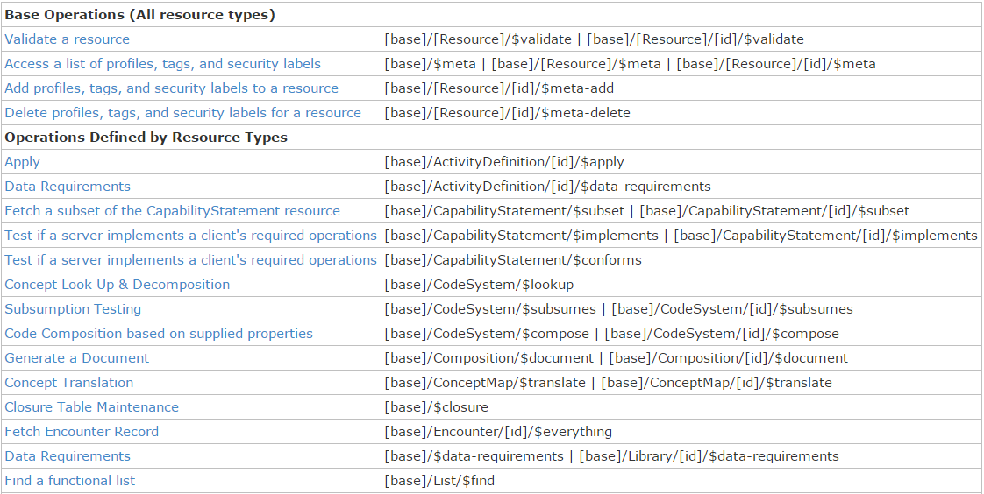
Example services

Slide 23
When to use Services?
All previous paradigms are a type of services interface
Use a custom service when capabilities of other paradigms don’t fit requirement
Operations other than CRUD on a resource (e.g. decision support)
Workflow more complex than simple request/response
Need to mix document persistence with behavior
Services
Notes:
Services make sense when the other options don't work
Rather then request response, you want to send one set of information to A and another to B, and they are going to coordinate with System C for an answer to communicate with B/C to get your answer
Maybe you need to mix behaviors

Slide 24
When not to use services?
When something else will do the job as well
I.e. Don’t define a custom service for something that already naturally is handled by REST, messaging, etc.
Services

Slide 25
Paradigm guidance
No absolutes
Consider a “when to avoid” as a note of caution
Capabilities/architecture of legacy will often drive approach, particularly initially
E.g. If v2 back end, messaging
Architectures will be driven by legacy requirements, architectural preferences, enterprise architecture commitments, etc.

Slide 26
Combining paradigms
No requirement for a system to only support one paradigm
E.g. hospital may be primarily messaging, but use documents for discharge summaries and reports and expose registries and appointments via REST with a few custom services for decision support or specialized workflow
Data (generally) shared easily across paradigm boundaries
Notes:
Consider multiple paradigms when creating instances – don’t want to have to re-craft the narrative because you want to use a resource now in a document instead of a message

Slide 27
Caveats with combining paradigms
If updates come in via document, message or service, RESTful version id still needs to increment
Documents should typically be persisted whole, not reconstituted from parts
Ensures signature validity
Legacy messaging systems may not provide the metadata to easily expose or manipulate discrete resources via REST

Slide 28
Apply it
What paradigm(s) are you like to use in your organization and why?

Slide 29
FHIR Architecture Approaches

Slide 30
Some possible uses
v3
App
v2
FHIR
PHR
FHIR
Broker
Comm.
Interface
FHIR
DB
Notes:
You’re a message broker routing and translating between v2, v3 and FHIR
Your app interfaces with a PHR using FHIR natively
Your application can communicate using FHIR, but your software uses a proprietary RDBMS
Use FHIR as the common language for a Vendor Neutral Archive
…Or a combination….
You might see data as a nested structure of XML, a series of tables with keys, class-diagrams….

Slide 31
Repository model
HIS
LIMS
PACS
SystemX
Gateway
FHIR
FHIR
FHIR
FHIR
FHIR
Vendor Neutral Repository

Slide 32
Beyond exchange
v3
Other
v3
v2
Other
v2
Decision Support
Broker
FHIR
FHIR
Repository
FHIR
X12
Notes:
FHIR can be your shared persistence layer – nice granularity for storage, extensions for handling “extra” stuff easily
FHIR can be the common model for your mapping layer
FHIR can be the logical model used for decision support, both to expose your data to the decision support engine as well as to define rules (work in progress with vMR-CDS and CQI)

Slide 33
Overview of a server
HTTP / REST interface
Encoding/decoding, param validation, syntax validation
Implement service operations as described in spec
Fhir Service
Indexer / Search
Storage
Notes:
-HTTP front end – knows how to encode/decode parameters, valid syntax and parse headers – most likely able to find off the shelf for your language of choice
-FHIR Aware – need something that /patient and /observation mean something different. And what type of operations are permitted.
-Persistent layer – sometimes you put into one, or you have a secondary repository for search. Index layer is important because FHIR defines search paramters – expect case-insensitive and no accents.
If you are querying against quantity and you want it normalized for unit of measures, or diagnoses that handle subsumption testing…this works because FHIR has a defined set of search query.

Slide 34
From wire to store
REST interface
JSON/XML
JSON/XML
JSON/XML
FHIR Parser
FHIR Parser
FHIR Parser
Fhir Service
POCO/POJO
POCO/POJO
POCO/POJO
O-R Map
Serialize
Serialize
Storage
NoSql (Xml/Json)
DBMS
DBMS
Notes:
Data starts at restful interface.
Parser – with reference implentation or your custom parser. Don’t have to do it. Can manipulate JSON/XML directly, but conversion to object model is helpful.
-Plain Old Java Object
-Plain Old CLR Object -- Common Language Runtime is used for .NET
--
Receive in whatever format then map
And parse to your object model and then decided how to persist
3 approaches we have seen
Object relational-map - use a tool, something like hibernate to map form internal model and database tables
NoSQL - couchdb where you are storing JSON/XML directly or trimming to triple store
Relational structure, but you don't break into individual columns, you store as blob in your database and build the index. And this works because you have index repo that does all searching and when you retrieve date you are providing resource, not individual columns. Some systems will store both full and summary in blob so you don't have to create on fly.
--
(object reltFirst scenario is most common for existing databases: you have to map the FHIR structure (as POCO’s) onto your (existing) databases tables. Lot’s of mappings to support our nesting, cardinalities, data types
Second scenario uses the parsers to create POCO’s then use a NoSql driver’s serialization possibilities to store the structure-as-is in NoSql
Third scenario uses POCO’s and DBMS, but instead of mapping FHIR to tables, stores the data as-is into blob storage in a DBMS

Slide 35



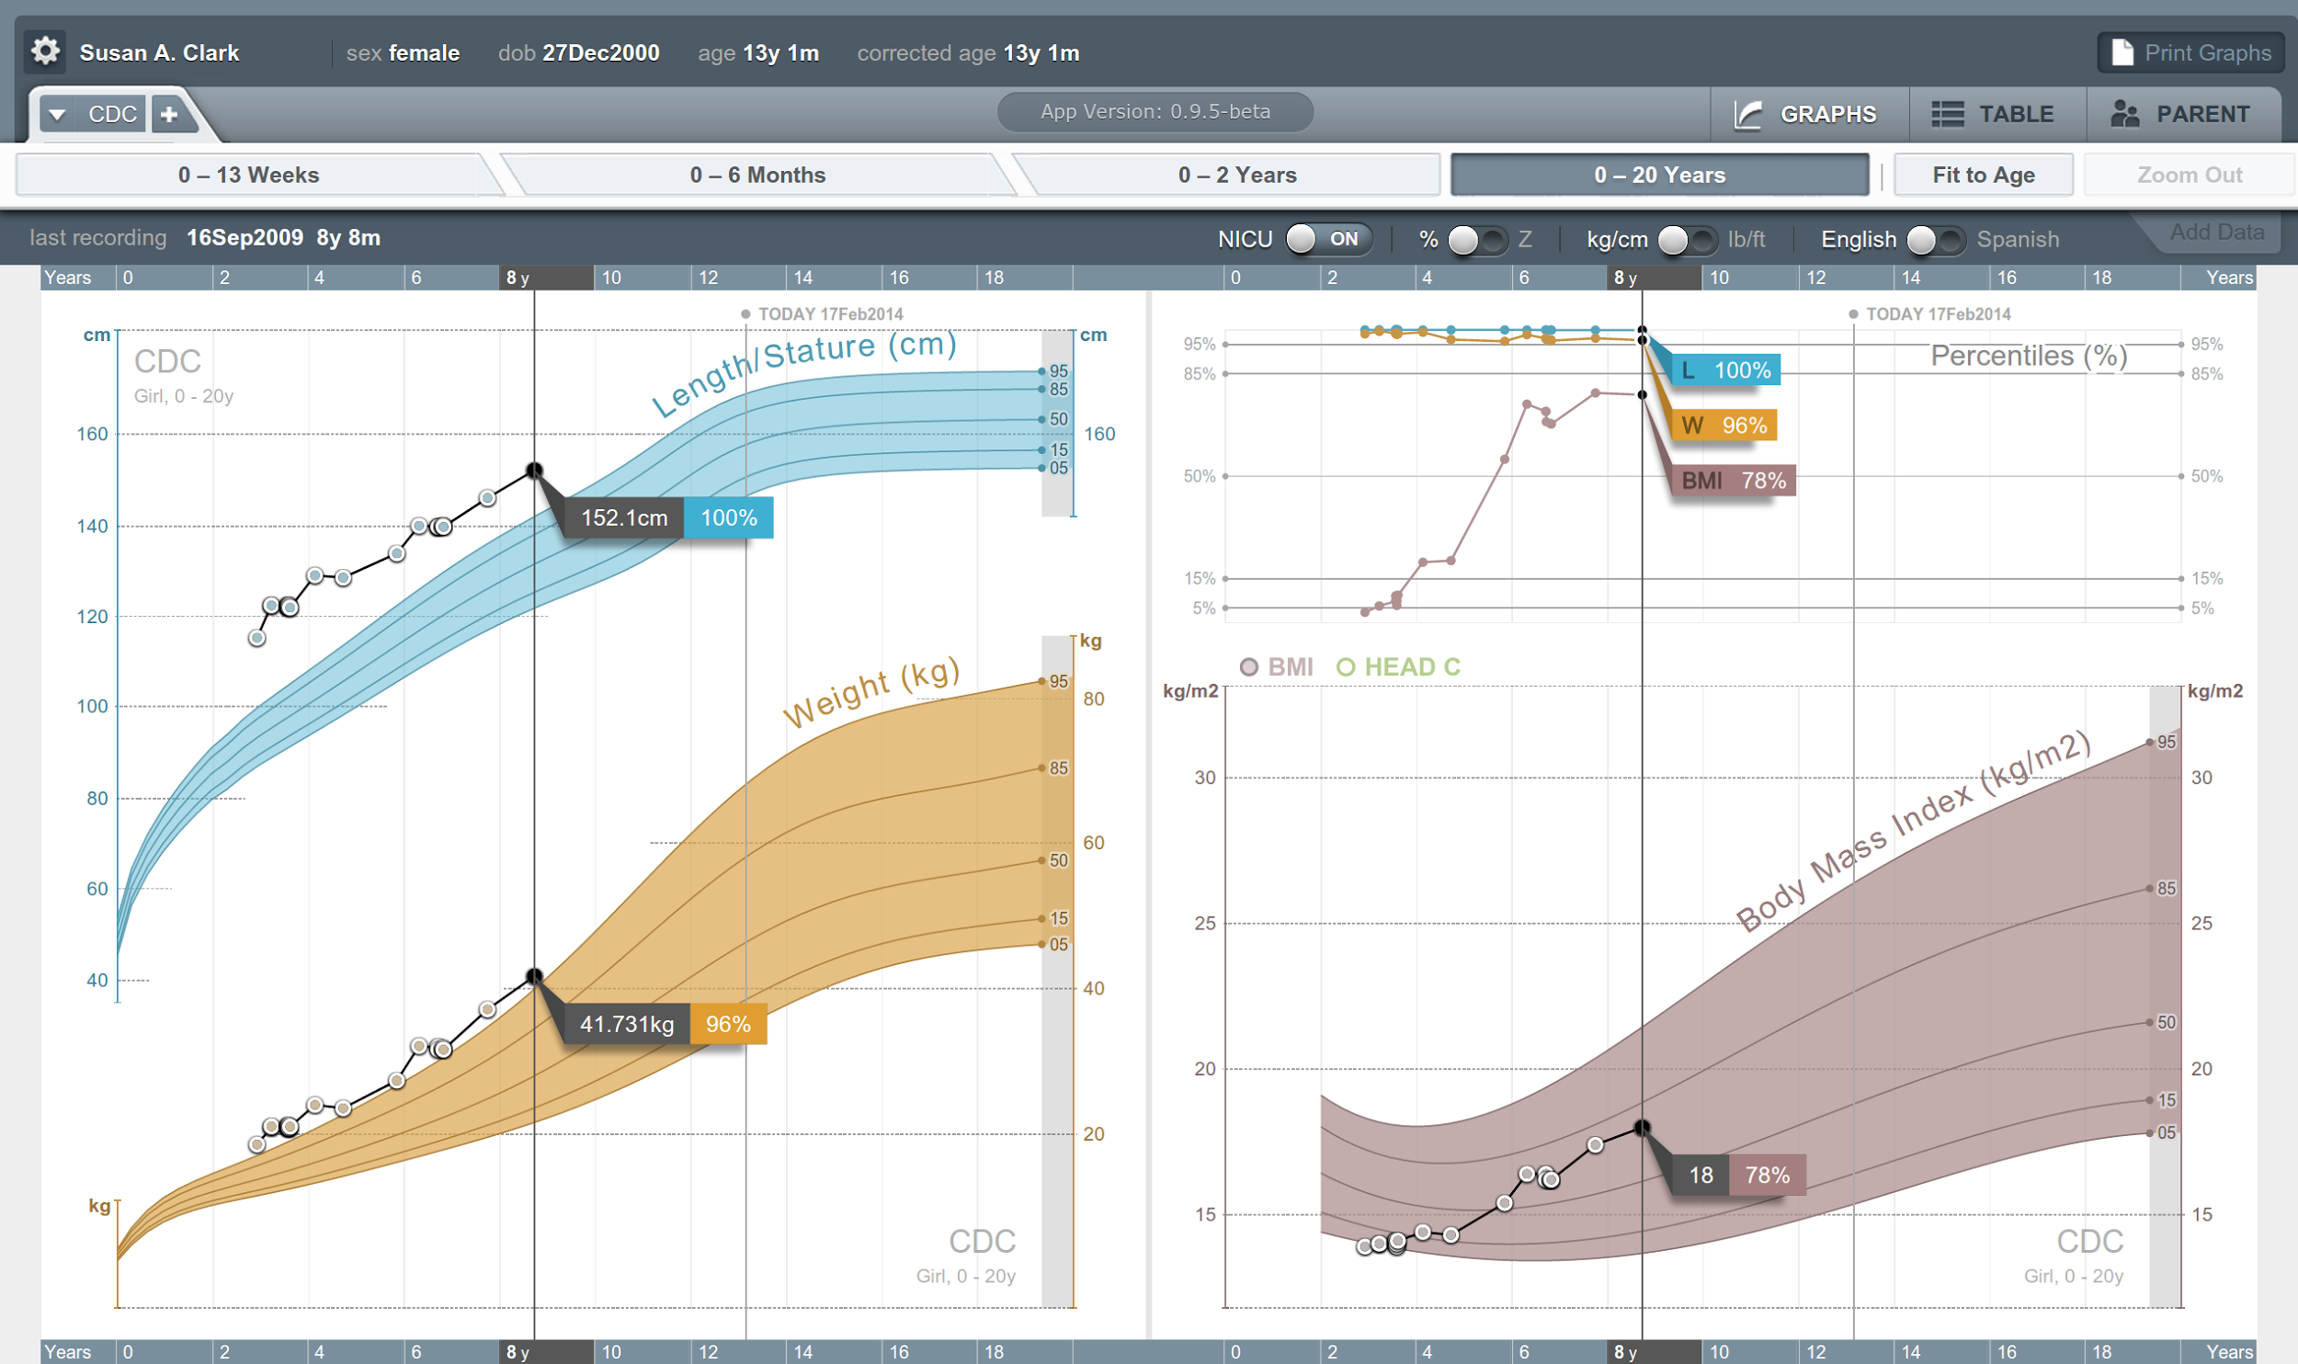


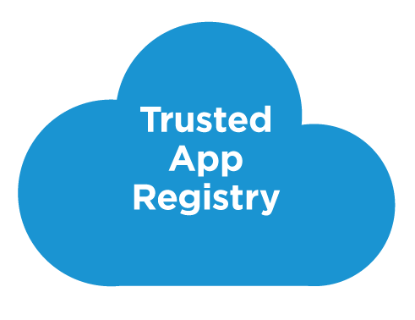



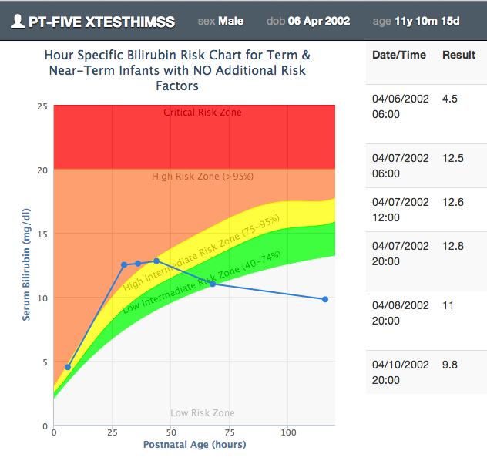







SMART on FHIR
Mobile Apps
Web Apps
OAuth2
REST API
MU-oriented FHIR Data Profiles
Underlying Health IT Systems
Your system here.

Slide 36
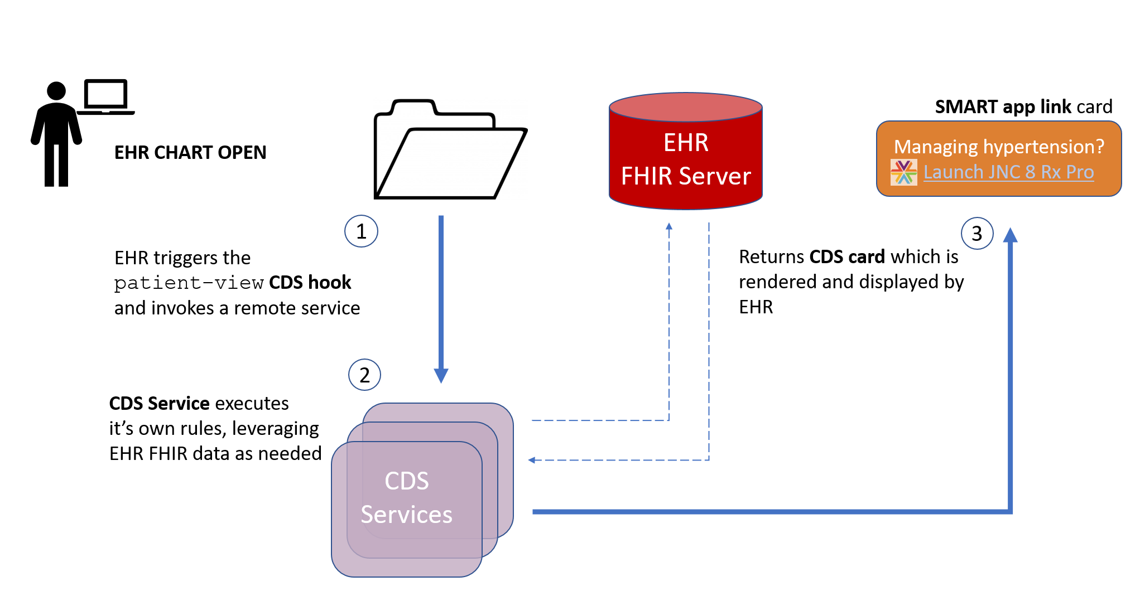
CDS Hooks

Slide 37
Architectures
FHIR makes no assumptions about the architectural design of systems
You can use it for
Light or heavy clients
Central server or peer-to-peer sharing
Push or pull
Query or publish/subscribe
Loosely coupled or tightly coupled environments
With history tracking or without

Slide 38
Bottom Line
FHIR is a set of tools
Defined resources
Extensibility mechanism
Set of standard interfaces
Primary purpose is interoperable data exchange
However, it can be leveraged in many ways
Many we haven’t even thought of yet . . .

Slide 39
FHIR Features
And the architecture decisions that go with them
Notes:
10:00

Slide 40
FHIR Features
Narrative
Extensions
Modifier Extensions
Versions
Tags
Syntaxes
Signatures
Reference Libraries
Conformance Resources
Bundles

Slide 41
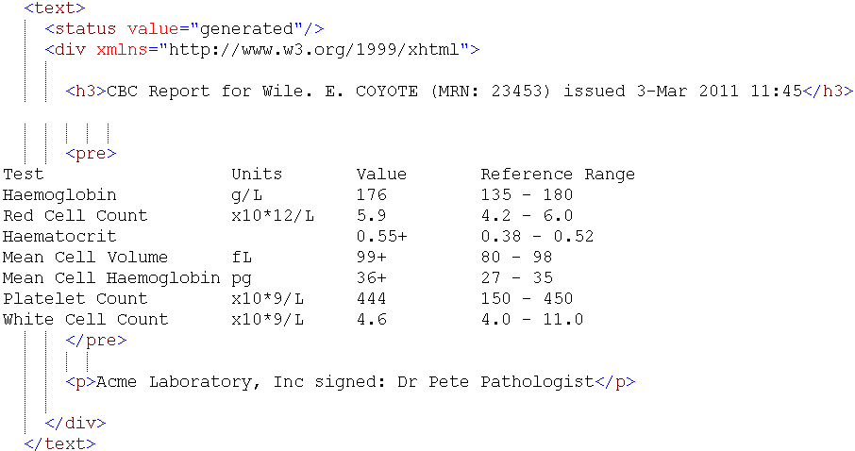
Narrative

Slide 42
Narrative
All resources are expected to have narrative except in narrow circumstances
May be generated or manually edited
Decisions
Should narrative be generated or human-entered?
Generated simplifies processing for receivers
Some text will need to human entered
In some cases, there may be minimal discrete data

Slide 43
Narrative decisions (cont’d)
If generated, which elements should be included? How should they be rendered?
all content needed for a human to understand the essential clinical and business information otherwise encoded within the resource
Will generally include modifierExtensions
May include other extensions
Best to seek clinician and other review of content, order of presentation & rendering
Consider that content may be rendered on mobile devices, so don’t get too fancy with markup

Slide 44
Narrative decisions (cont’d)
Should narrative be displayed to users?
Driven by Narrative.status
Business requirements (e.g. Document attestation) may drive need to render regardless
Notes:
If “generated” and system renders all core elements deemed “essential” human/business understanding, then no need to display narrative
If “extensions”, then can only suppress if all received extensions are understood and system renders all received core elements & extensions needed for human/business understanding
If “additional”, must always make narrative available to view

Slide 45
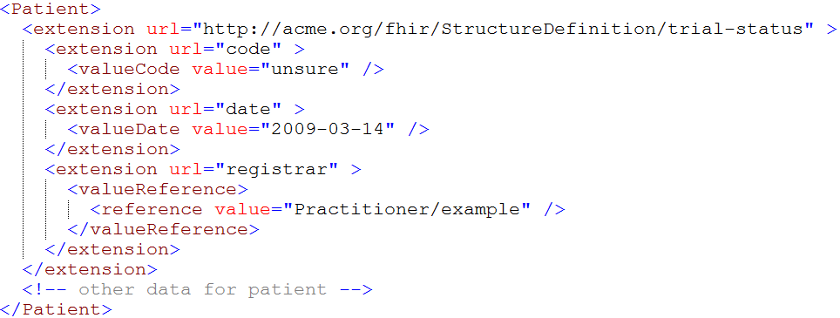
Extensions

Slide 46
Extensions (cont’d)
In FHIR, extensions are “normal”
Consequence of the 80% rule – keep the simple stuff simple
Extensions can exist anywhere
Yes, even inside boolean or date
Systems shouldn’t reject instances just because they contain unrecognized extensions

Slide 47
Extension decisions
Should unrecognized extensions be persisted? How?
Throwing away extensions = loss of potentially useful information to downstream systems
Therefore: Keep extensions if you can
Can capture them in a blob or a generic “slot” structure
Could, with location tagging, capture all “unknown” extensions for a resource in a single blob
Some legacy systems won’t be able to
When data is updated, some extensions must be dropped

Slide 48
Extension decisions (cont’d)
Should you display unrecognized extensions?
Extensions are identified by URL and have a known data type. Can resolve the URL, look up the name and display
Cost/benefit question – some extensions will have little value, others may have a lot
Might want to let users configure what gets displayed
If you do query, look at caching extension definitions to minimize performance issues

Slide 49
Extension decisions (cont’d)
What should you expose as an extension?
If data can be exposed using core structures, it should be
Can still send the same data in an extension
e.g. with more/less granularity, alternate coding, different data type
Look for existing extensions before defining your own
Extensions, if used, should be generic to encourage re-use (and thus broad recognition)
Extension should be on the element described by the extension

Slide 50
Extension decisions (cont’d)
Where to register extensions
Considerations:
What’s the scope? For local extensions, a local registry may make more sense
Is there a need for restricted access?
In general, broad registration = discoverable = broader uptake = broader recognition

Slide 51
Modifier Extensions
Also a core part of FHIR
Needed because some extensions can’t be safely ignored
Can’t compute on an element containing an unrecognized modifier extension. However, can:
Reject instance
Remove element containing unrecognized modifier extension
Just display narrative
Retrieve definition & seek human review

Slide 52
Modifier Extension decisions
When should you introduce them?
modifierExtension breaks interoperability so:
If you can accomplish your objective without one, do that
Consider a new resource or Basic
Could requirement be met by an element that doesn’t change other element interpretations?
Best used when already part of existing practice, but in too narrow an area to justify being part of core

Slide 53
Versions
33, v12 – 2012-12-04
/server.org/fhir/Patient/33/_history/12
33, v13 – 2012-12-05
/server.org/fhir/Patient/33/_history/13
33, v14 – 2012-12-08
/server.org/fhir/Patient/33/_history/14
33, v15 – 2012-12-09
/server.org/fhir/Patient/33/_history/15
/server.org/fhir/Patient/33
Notes:
* Note that you have two ways (at one moment) to reach version 15

Slide 54
Versions (cont’d)
FHIR allows versions to be tracked and retrieved
Do you want to support versioning?
May be difficult or impossible with some legacy data stores
Will still need to have unique version id (UUID, timestamp)
Provides useful collision-detection mechanism

Slide 55
Pop Quiz
Where can extensions appear?
When must a receiver process an extension?

Slide 56
Tags
Patient
MRN 22234
“Ewout Kramer”
30-11-1972
Amsterdam
Tag: system: http://example.org/fhir/Status
code: Test
Profile: http://hl7.org/fhir/StructureDefinition/us-core

Slide 57
Tags (cont’d)
Allow data to be attached to a resource “outside” the resource
Doesn’t break signature when added/changed
3 types:
Security
Profile
General (workflow, etc.)
Require business agreement
Can’t search by tag if authors don’t include them
And populate the same way . . .

Slide 58
Tag decisions
Tag vs. extension?
Use extension if:
Element is associated with the business object rather than electronic record
Part of attested content of resource
Should be included in narrative
Change should force new version

Slide 59
Syntaxes
XML
JSON
<XXX xmlns=“urn:foo”>
<B a=“c” />
<C>One</C>
<C>Two</C>
<D>One</D>
<div>Not <b>so</b> easy</div>
</XXX>
{ “B”: { “a” : “c” },
“C”: [ “One”, “Two” ],
“D” : [ “One” ],
“div” : {
“text-before”:“Not ”,
“b”:“so”,
“text-after”:“easy”}
}
Notes:
We tried to find a way to automatically convert between the two so you could round-trip…
But discovered you’d need additional metadata to do that, or vendor-specific solutions
Decided not to introduce these: result was weird Xml or weird Json
Reference platform contains tools to interconvert (these use model definition metadata)

Slide 60
Syntaxes (cont’d)
Multiple representations
XML, JSON, Turtle (RDF)
Reference implementations support both and conversion between
Maximizes interoperability
Inter-conversion is robust enough for digital signatures if the signatures are based on the canonicalized representation

Slide 61
Syntax decisions
What syntax should be used when?
XML used to be required for servers
Now implementer’s choice
XML provides broader tools
XSLT, schema, XPath
JSON uses less bandwidth, more natural for mobile
Turtle/RDF is niche
ideally, servers support all
maximum interoperability

Slide 62
Signatures
Three ways to digitally sign content
Sign bundle (Message or Document)
Sign resource version using Provenance resource
Limited to data integrity
Extension (for more complete signature)
No requirement to sign content
Signatures are just one mechanism of ensuring data integrity and/or non-repudiation
Signatures only hold when converting between different syntaxes when data is canonicalized

Slide 63
Reference libraries
Currently 5:
C#, Java, Pascal (Delphi), Javascript, Swift
More to come?
Handle parsing, serialization, validation, etc.
Also open source servers, basic clients

Slide 64
Reference library decisions
Use a reference library vs. build your own?
Same criteria as any other “build vs. reuse”
Build costs more, but more tuned
At minimum, consult reference implementations to ensure you don’t miss nuances of specification
How often to update?
Reference libraries changing frequently
Will need to manage updates, especially given that custom code is likely resting on top

Slide 65
Conformance resources
StructureDefinition, ValueSet, ConceptMap, NamingSystem, CapabilityStatement, etc.
Provide “metadata” for operation of systems
Allow for “dynamic” configuration
E.g. Rather than having hard-coded rules for allowed codes, required elements, look it up in ValueSet or StructureDefinition resource
Can be hosted anywhere
Do you require a local copy for performance reasons? Perhaps synchronized copy via publish subscribe?
Notes:
Server that is FHIR compliant Must support.
Declares which messages a server supports, which documents
"Clients can dynamically configure, adjust user interface and capabilities accordingly.'
A client needs to be able to provide one if you want to claim fhir conformance
You coul

Slide 66
Conformance resources (cont’d)
Often arranged in cascading hierarchy
E.g. International value set, national value set, local value set
Need to consider timeframe and mechanism for propagating changes from higher levels in the hierarchy
Notes:
May have a profile defined by IHE, and then narrow defined by ONC, and then narrower of hospital.
Need to have a process in place to update your own profile when profiles higher in hierarchy chnage

Slide 67
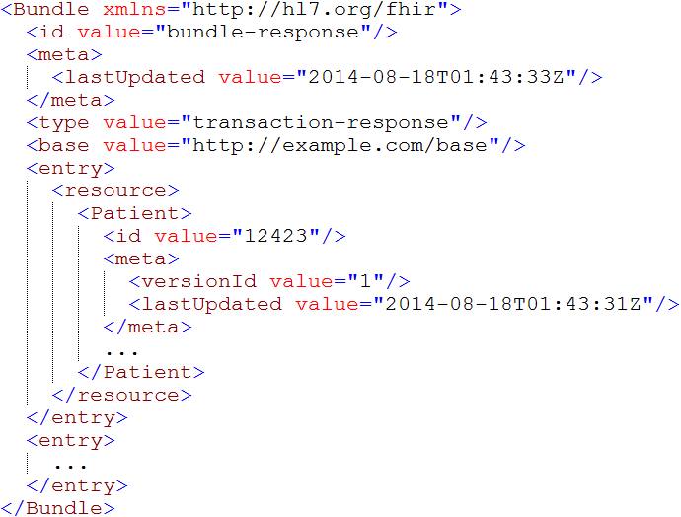
Bundles
Notes:
Note that the id of the resource is kept outside the resource itself
Bundle has many other meta-data items (not shown), which we will discuss later.

Slide 68
Bundles (cont’d)
Mechanism for messages, documents, transactions, query responses
In theory, could regenerate a document from constituent parts, but:
No clear boundary on what’s part of document vs. not
No way to guarantee order of entries
Thus: recommend storing as a binary

Slide 69
Bundle decisions
Ids within a bundle
Resources in bundles can be identified by UUID, RESTful id or version-specific RESTful id
RESTful ids allow information in a document to be linked to existing resource instances outside the bundle.
Version ids should be used if data corresponds to a specific version (as opposed to filtered view)
Notes:
-reference by a few different ways – used UUID when there is no RESTful reference for a element
-server specific id, but version independent, so if practitioner previleges/licensing/contact information is updated

Slide 70
Bundle decisions (cont’d)
Where’s the resource – bundled, contained, remote?
“contained” should only be used if resource can’t stand alone
Can’t exist if parent is removed
Not enough information to resolve
In bundle for document if part of narrative rendering rules or want part if signed content
In bundle for message if needed to process message and no separate query desired
Notes:
Contained isn’t a packaging method – used when resource isn’t stand alone.
Say you want to record a prescription for Aspirin, you don’t want to create a medication resource for Aspirin when you don’t have dose/strength --- you would have 10k rows just medication. So we allow you to embed medication resource inside order if you don’t have a stand alone, and can’t reasonable make one.
Part of document
Remote – query for resource if not critical for processing message.

Slide 71
Apply it
Which of the previous FHIR considerations are you going to pay particular attention to in your implementation?

Slide 72
Additional Considerations
Notes:
10:00

Slide 73
Additional Considerations
Resolving identity
Missing data
Looping
Variable server capabilities
Prohibiting data elements
Interoperating with legacy

Slide 74
Resolving identity
Resource is electronic representation of real-world object
Can have multiple resource instances for same real-world object
Different servers or sometimes even same server
Ids for same resource on different servers can be completely different
Data on different servers can also vary
One resource multiple sites (with different ids)
Available data may vary

Slide 75
Resolving identity (cont’d)
Matching resources within and across servers is generally accomplished by business id (“identifier”)
May also have business “version”
Rules over changing business version are domain-dependent.
Where old versions my be maintained, each version might be distinct instance

Slide 76
Missing data
Extremely few resource or data type elements are required (minOccurs > 0)
Resources and data types are context independent
Extensions might supersede core elements
Therefore
Don’t assume data will be present
Always check for element/@value, not just element
May need to validate to a profile to enforce requirements

Slide 77
Looping
FHIR resources are interrelated in a network, not a hierarchy
Direct and indirect looping relationships are possible
In resource definitions & instances
Even if not possible with core elements, may occur with extensions
Parsing and processing algorithms must deal with this possibility
Notes:
-folks often think of healthcare in a hierarchy – all hanging off in a patient. That is NOT how things are setup in FHIR.
-you have a mesh, various records within an EHR record link to each other – when traversing the links, you may find loops, so need to build code so you don’t get stuck in an endless loop. Important when parsing records for import, or display, or etc.
E.g. Patient might update their own demographics. Organization might issue an identifier to itself, etc.

Slide 78
Variable Server capabilities
FHIR defines a number of mechanisms to give clients control of queries
Paging, many filters, _include, _summary, compartments
However, these are all optional . . .
What should a server do?
Cost/benefit trade-off
More you support, more clients will work with you
Some capabilities may be very expensive in some architectures
Do as much as you can, “within reason”

Slide 79
Variable Server capabilities (cont’d)
What should a client do?
Take advantage of desired capabilities, work with narrow set of servers
Works well in closed environments
Use minimal capabilities, work in most/all environments
Use advanced features where available, fallback to client processing where needed
More efficient but more complex client

Slide 80
Prohibiting data elements
In FHIR, you shouldn’t prohibit unknown extensions or unsupported data elements
You can set a maxOccurs=0 for data elements
This forces clients to customize what they send you – bad practice
Better to accept and ignore
In limited cases, may be liability issues with ignoring data, so rejecting is necessary

Slide 81
Interoperating with legacy
How do you make FHIR play nicely with v2, v3, CDA?
Not enough time to cover here
Look at
http://hl7.org/fhir/comparison.html
https://healthlevelseven.desk.com
(members only)

Slide 82
Profiled FHIR
Notes:
10:00

Slide 83
Profile-less FHIR
You don’t need profiles to interoperate with FHIR
Resources are “discrete” enough that mechanism to populate most elements is clear
Approach
Populate/consume all elements you know, use HL7 or country-standard extensions for extras
Map to/from “recommended” terminologies as much as possible, populate CodeableConcept.text
Expose capabilities in CapabilityStatement resource
Notes:
With profile, they can interoperate ‘ok’.

Slide 84
Profile Uses
Profiles are still quite useful
Define document and message boundaries
Define extensions
Set interoperability expectations in a particular context
National standards, types of care, business patterns
Clinical practice guidelines / detailed clinical models
Document system capabilities

Slide 85
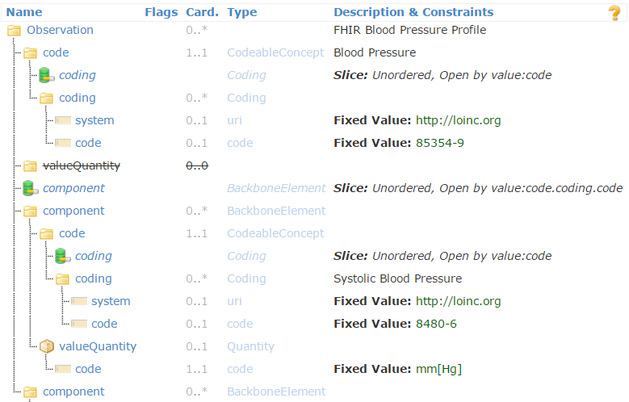
Profiled Observation (Blood Pressure)

Slide 86
Profiles to guide behavior
Profiles can be used to dynamically configure system behavior
Load a profile to guide data entry
E.g. Oncology referral
Load a profile to guide data display

Slide 87
Simultaneous profiles
Multiple profiles can apply to an instance at the same time
Different Codings for different value sets
Include the union of all needed elements
Works best when profiles don’t constrain max occurrences

Slide 88
Declaring profiles
Instances can identify what profiles they support using tags
Considerations:
Is declaration version-specific?
Do you trust the declaration to be accurate?
Will all clients declare the profiles of interest on submissions?
What about profiles of interest defined after data is received?

Slide 89
What now?
Notes:
10:00

Slide 90
Dealing with STU
FHIR is a “standard for trial use”
Anything can change – no compatibility promised
Changes driven by implementation feedback
Most changes expected in resources
Already significant implementation experience through reference implementations, connectathons
Some needed resources aren’t yet defined
Outbreak, Public Health Case, etc.
Some content will (hopefully) become normative in FHIR R4 (2018), but most won’t
What goes normative when will depend on degree of implementation

Slide 91
STU Strategies
If multiple STU versions could be in play
Distinguish using extensions or distinct endpoints
Be prepared to transform between versions to move/rename elements or handle syntax changes
For missing resources
Use Basic
Create your own custom resource
Non-conformant, but ok during STU in closed community

Slide 92
FHIR adoption approaches
Low hanging fruit
Registries
Terminology
MHD (XDS)
CCDA interface
Patient Portals / Mobile Health
Others?

Slide 93
FHIR adoption approaches (cont’d)
Trial & experiment
Green-field
Pilots
“good fit” solutions (mobile, social media)
Elements not standardized elsewhere
Questionnaire, ConceptMap, etc.

Slide 94
FHIR adoption approaches (cont’d)
Deep dive
For the brave
May be premature during STU period, given that specification is likely to change
Ability to adapt to change is essential

Slide 95
FHIR adoption approaches (cont’d)
Monitor
Wait for next release, normative, jurisdictional direction (e.g. meaningful use)
Wait for stability in reference implementations
Wait to see more implementation experience
Ignore
FHIR isn’t relevant to my environment now and is unlikely to ever be
Notes:
If you think you’re in the last category, would love to chat with you

Slide 96

Estimating
How much will implementing a FHIR solution cost?
Considerations
Reference implementations help
Learning curve is lower
Still a curve if unfamiliar with XML / JSON / REST
Faster to “drive by” interoperability
Can’t speed consensus
Tools to help with mapping to internal codes and structures, still takes time
Anecdotal is “faster” to “significantly faster” to implement
Notes:
If I had a guaranteed answer, I’d be too busy to teach this course . . .

Slide 97
Skill requirements
To implement a FHIR solution, you’ll need:
Knowledge of XML and/or JSON
Some degree of familiarity with HTTP (assuming REST)
Likely someone knowledgeable in HTTP security and possibly OAuth

Slide 98
Considerations
What’s giving you pain now?
How could FHIR address those pain points?
What worries you about using FHIR?

Slide 99
Time-points for re-evaluation
Q4 2018: FHIR R4 published
with some normative content?
Additional releases every 18-24 months

Slide 100
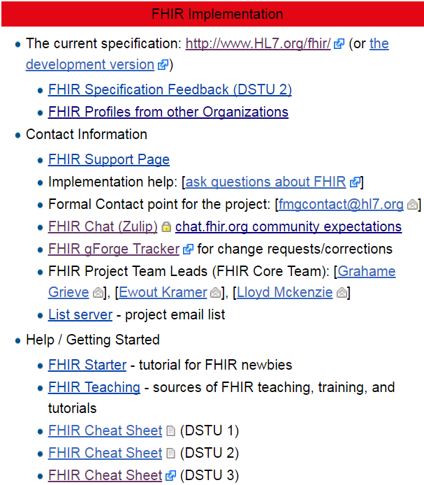
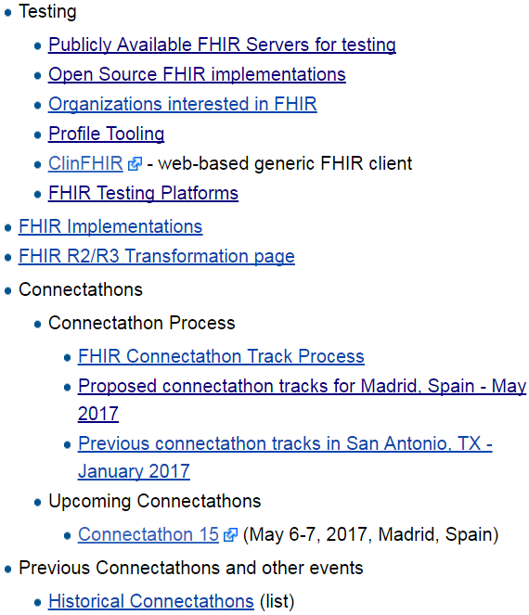
Resources wiki.hl7.org/?title=FHIR

Slide 101


Next Steps for you
Attend other FHIR tutorials
Developers, Profiles, Deep Dive
Read the spec: http://hl7.org/fhir
Join http://chat.fhir.org
Follow #FHIR on Twitter
Shape the specification:
Join the FHIR track at this WGM
Feedback – chat, tracker, list server
Try implementing it
Come to a Connectathon!

Slide 102
Education opportunities
Attend a Working Group Meeting
Tutorials, Connectathons
Jan 26-Feb 2 New Orleans
May 11-18 Cologne
Sept 28-Oct 5 Baltimore
FHIR Institute Webinars
Oct 20-24
Dec 1-5
Custom education available

Slide 103






International HL7 FHIR Developer Days November 15-17, 2017 in Amsterdam
(And for the first time in the U.S.: June 19-21, 2018)
Education
12 speakers
16 tutorials/presentations
18 tracks
Connectathon
Meet fellow developers
Put FHIR to the test
Networking
FHIR experts and authors on hand
http://fhir.furore.com/devdays

Slide 104

Show Us Your Apps!
Dec 5 – 6, New Orleans, LA
15 minute presentation of your functioning FHIR app
Deadline: October 15, 2017
http://bit.ly/presentfhir

Slide 105

Questions?
http://hl7.org/fhir lmckenzie@gevityinc.com

